Slide 1
Table of Contents
Acronym List | 4
Message from the Division Chief | 5
Year in Review | 6
Introduction | 7
DHA J-7 Leadership Overview | 8
DHA J-7 CEPO Overview | 9
Accreditations Overview | 10
Program Data Overview | 12
Data Analysis Summary | 13
Applications and Educational Content | 14
Top Activities and Engagement | 15
Learner Employment Sector and Region | 16
Uniformed Service Members and MTFs | 17
Learner Trends and Professions | 18
Credit Types Awarded | 19
Marketing and Collaboration | 20
Marketing and Outreach | 21
Collaboration with our Partners | 22
Event Planning | 23
Financial Impact | 24
Cost Savings and Return on Investment | 25
Recommendations for the Year Ahead | 26
Key Takeaways and Recommendations | 27
Appendix | 29
Event Series Data | 30

Slide 2
List of Tables
Table 1. Top 10 Offerings by Number of CE/CME Credits Awarded | 12
Table 2. Top 10 MTFs by Number of CE/CME Credits Awarded to Affiliated Learners | 14
List of Figures
Figure 1. Monthly Applications Submitted in 2023 vs. 2024 | 11
Figure 2. Top CE Activities by Number of Unique User Enrollments and Completions | 12
Figure 3. OCONUS Countries and Territories with Learner Enrollments | 13
Figure 4. Percentage of Service Member Credit Earners from Each Branch | 14
Figure 5. Top Eight Professions by Number of Credit Earners per Corresponding Credit Type | 15
Figure 6. Number of Credits Awarded by Credit Type | 16

Slide 3
Acronym List
AAPA | American Academy of Physician Assistants
ACCME | Accreditation Council for Continuing Medical Education
ACHE | American College of Healthcare Executives
ACPE-Pharm | Accreditation Council for Pharmacy Education Pharmacist
ACPE-Tech | Accreditation Council for Pharmacy Education Technician
ADA | American Dental Association
AHIMA | American Health Information Management Association
ANCC | American Nurses Credentialing Center

Slide 4
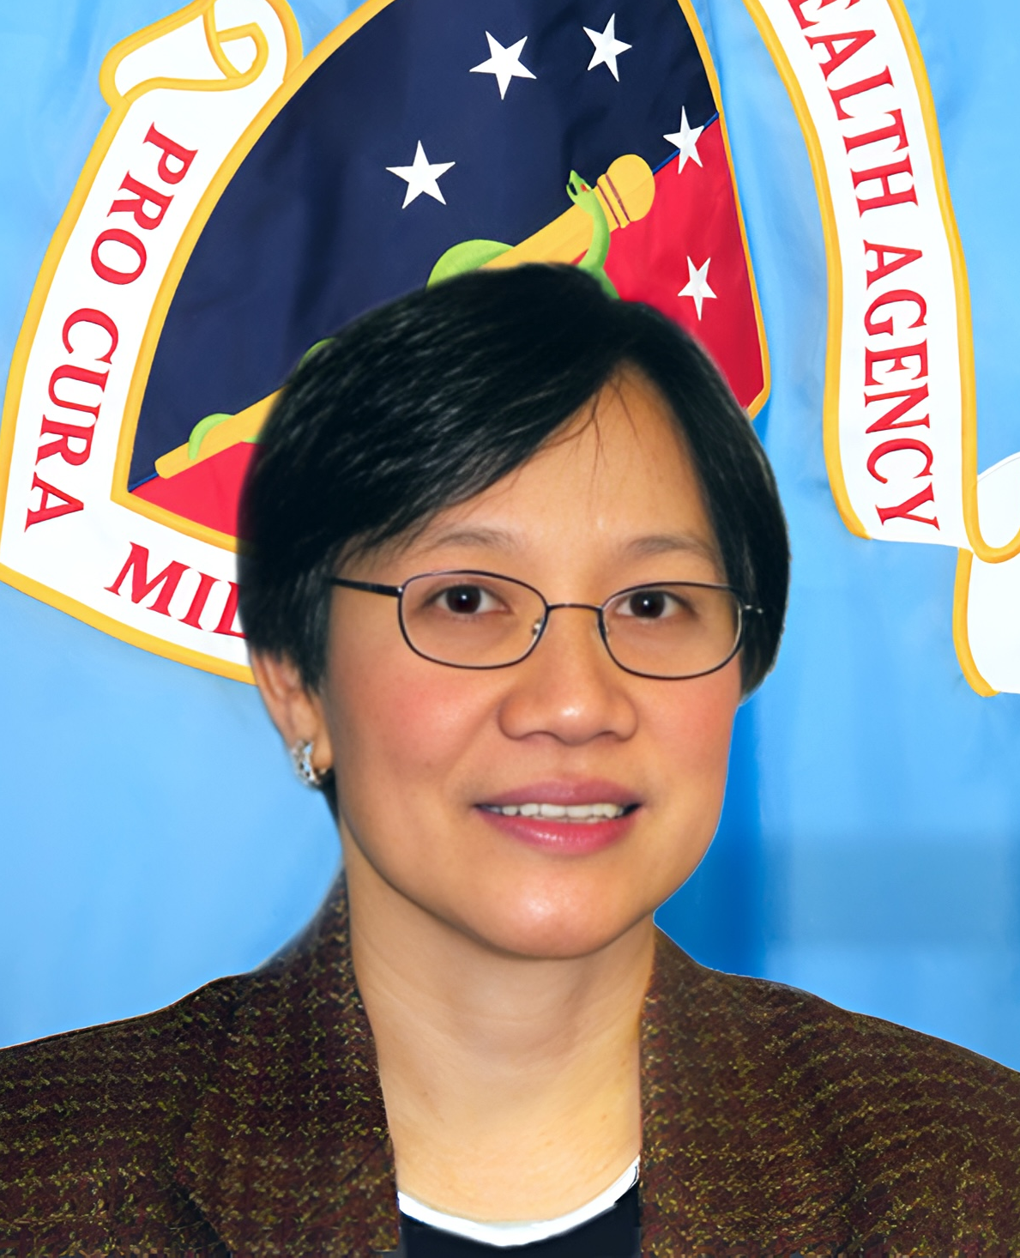


Message from the Division Chief
Greetings,
The Defense Health Agency, J-7 Continuing Education Program Office has continued to expand accredited learning opportunities to civilian, contractor, and military personnel, focusing on best practices, interprofessional collaboration, and military readiness. I am excited to highlight CEPO’s impact across the military healthcare enterprise in calendar year (CY) 2024. Some of our key accomplishments include:
Clinical Communities Speaker Series (CCSS) events: The CEPO team hosted five CCSS events in 2024 with a total of 4,503 enrollments and 9,583.50 continuing education/continuing medical education (CE/CME) credits awarded. These events offer timely insights from experts in academia, government, and clinical care settings to address interprofessional practice gaps among MHS providers and teams.
Network and MTF Directors Symposium: The CEPO team collaborated with DHA stakeholders to support the Network and Military Treatment Facility (MTF) Directors Symposium in September 2024, awarding 880 CE/CMEs. Leveraging an event planning tool, the team managed over 500 attendees from all nine Defense Health Networks as well as the Defense Health Headquarters (DHHQ). The CEPO team also provided on-site support throughout the five-day event.
Engagement Outside the Continental United States (OCONUS): Over 1,380 healthcare professionals in at least 40 countries or territories in the OCONUS service area enrolled in a CEPO-accredited activity in 2024. Among those enrolled, over 1,100 completed the CE requirements for a total of 13,101.50 CE/CME credits awarded.
Our goal in 2024 was to assess the effectiveness of CEPO events in enhancing the clinical practice of healthcare providers. The CEPO team held six focus groups throughout the year, with our Department of Veterans Affairs (VA) counterparts moderating two discussions among VA participants. Our takeaways from the focus groups will inform and enhance our programmatic activities as we continue to prepare for Joint Accreditation (JA) reaccreditation in 2025.
I am looking forward to all that 2025 will bring, such as continuing our partnerships with the VA, OCONUS Commands, Centers of Excellence (CoE), and other parts of DHA to support CE activities. I am particularly proud of the strength of our partnership with the VA, which has grown through initiatives such as the 2024 focus groups. I know that our collaboration will continue to bring value to healthcare professionals serving the Military Health System and VA communities.
I am excited for CEPO to continue providing educational opportunities to the MHS community and beyond.
Sincerely,
Lolita O’Donnell, PhD, MSN, RN
Division Chief, Executive Skills, Continuing Education & Libraries (EXCEL)
Director and Academic Superintendent, CEPO

Slide 5
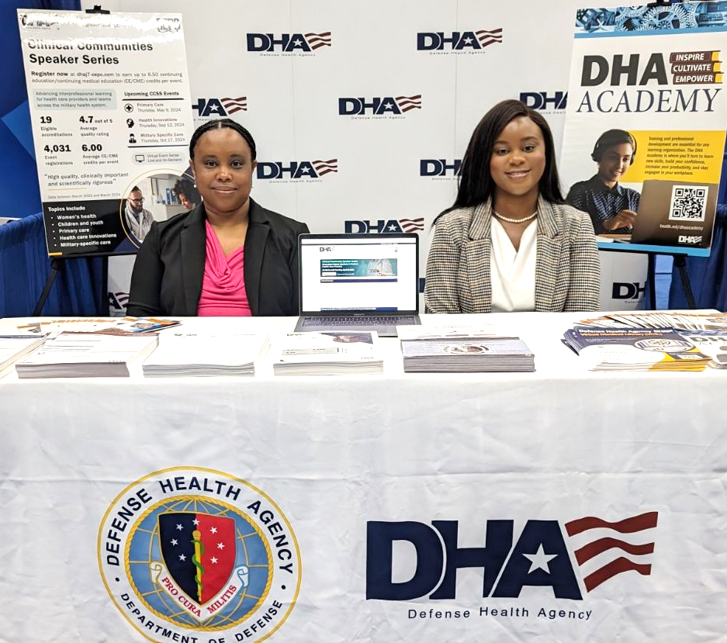
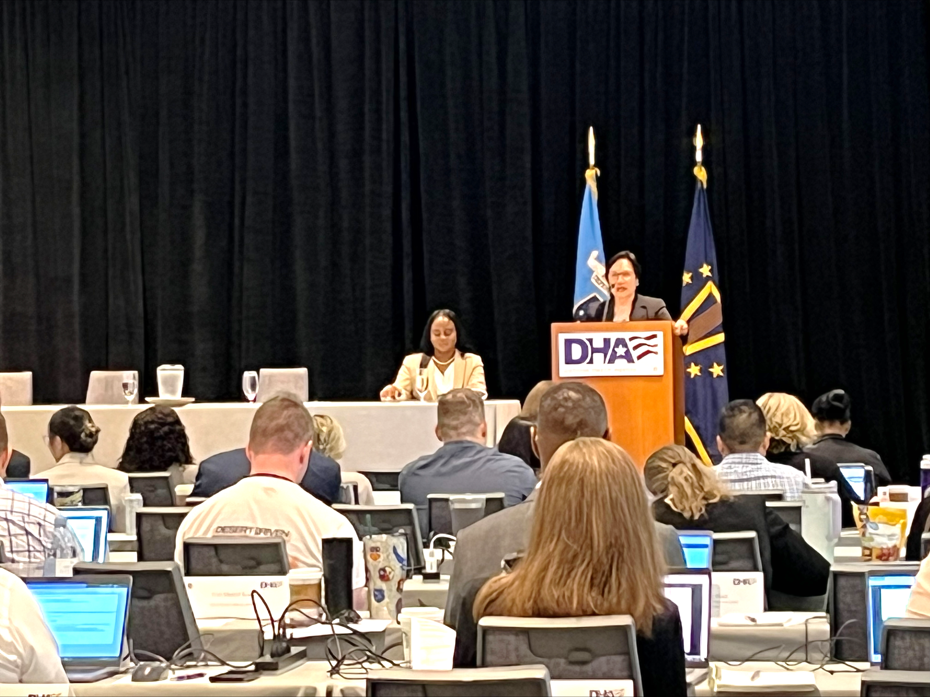
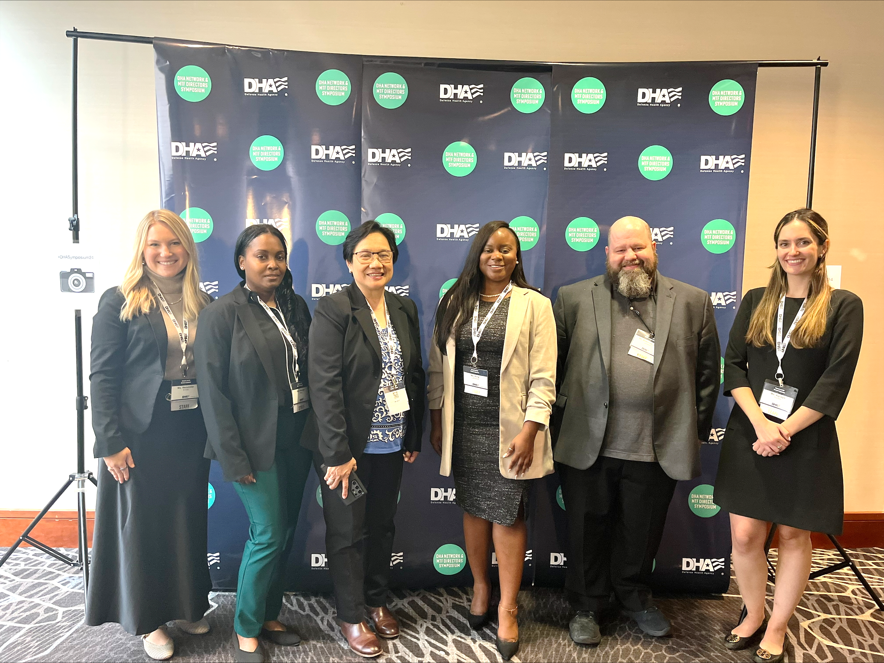
Year in Review
The CEPO team is pleased to submit the 2024 Annual Report. This report provides an analysis of CEPO-accredited activities and collaboration efforts, illustrates annual cost savings, and highlights important accomplishments and recommendations for the year ahead.
2024
Provided CE/CME credit and staffed an informational booth at the MHS Conference in Portland, Oregon
Began preparations to apply for JA reaccreditation in 205 by creating a review timeline and drafting commendation sections
Continued to collaborate with the VA by engaging in a new Plan of Action, Milestones, and Measures (POAMM) for the VA/DHA partnership in FY25
Presented and staffed a booth at the Chief Medical Officer, Chief Nursing Officer, and Chief Dental Officer (CMO/ CNO/CDO) Training, in addition to providing CE and AV support
Supported the Network and MTF Directors Symposium with 500+ attendees by providing CE/CME credits, website and application design, and registration management
Hosted five CCSS events with over 4,500 total registrations
Conducted six focus groups to obtain feedback on CEPO’s CCSS events and CE program
Conducted 12 Interprofessional CE (IPCE) meetings with polling capabilities, new topics, and guest speakers
Provided 60% more CE/CME credits in 2024 than in 2023
2025

Slide 6
DHA J-7 CEPO Overview
CEPO’s primary directive is to support healthcare operations across the enterprise by assessing, reviewing, and awarding CE/CME credit for continuing education activities designed for U.S. military personnel. Nonetheless, all licensed healthcare professionals who care for veterans, service members, or military families can access CE opportunities and earn the credits required to maintain their licensure and practice at any MTF or VA hospital or clinic.
CEPO’s collaborative efforts extend to the VA, OCONUS commands, CoE, federal partners, and prominent educational institutions. Notable, high-visibility events include:
Clinical Communities Speaker Series Network and MTF Directors Symposium CMO/CNO/CDO Training Medical Readiness Command Europe (MRC-E) Health and Readiness Symposium | Joint Medical Executive Skills Institute (JMESI) courses Interagency Institute (IAI) for Federal Health Leaders MHS Conference DHA Opioid Prescriber Safety Training
CEPO’s mission is to expand access to continuing education that advances the evidence-based practices, military readiness, and interprofessional collaboration and skills of healthcare teams throughout the enterprise. This mission drives us to support military health organizations in and outside the Department of Defense (DoD) by accrediting educational activities for healthcare professionals and teams who support veterans, uniformed service members, and service members’ families.
The Strategic Priorities that guide us in achieving of our mission are:
To provide enterprise-wide support by meeting the diverse and evolving continuing education needs of interprofessional military healthcare teams.
To maximize engagement in life-long learning opportunities using effective education strategies and a supportive program infrastructure.
To ensure quality, integrity, and validity by upholding standards and procedures that ensure high-quality educational activities based on unbiased, evidence-based content.
To implement continuous program improvements by expanding opportunities to capture and/or incorporate learner feedback during the planning, implementation, and evaluation of CE activities.

Slide 7
Accreditation Updates for CY24
In support of the goal to provide team-based continuing education to healthcare providers across the enterprise, CEPO is an accredited provider for 19 accrediting organizations, including JA for IPCE. CEPO utilizes JA criteria and other accreditation standards to elevate education and training initiatives throughout MHS.
Joint Accreditation Distinction: As CEPO’s most encompassing accreditation, JA offers organizations the opportunity to be simultaneously accredited through a single, unified application process, fee structure, and set of accreditation standards. JA promotes IPCE activities specifically designed to improve interprofessional collaborative practice (IPCP) in healthcare delivery. A leading model for IPCP itself, JA establishes the standards for education providers to deliver CE planned by the healthcare team, for the healthcare team.
CEPO has made noticeable improvements to its processes and materials in preparation for its JA reaccreditation review in 2025. CEPO aims to achieve reaccreditation with commendation to obtain an extended six-year accreditation term and maximize its impact in the IPCE space. Improvements included:
Revising CEPO’s mission statement
Simplifying posttest requirements
Maximizing the commitment to change tool
Incorporating feedback from focus group discussions
Optimizing the CE website and other supporting material
Updating the course evaluation survey and CE activity application
CEPO team members also volunteered as Joint Accreditation surveyors to support JA in fulfilling its mission and further prepare for the JA reaccreditation application and interview. By participating in this process, CEPO surveyors enhanced their personal and professional development and advanced their understanding of the accreditation requirements.
The JA distinction is awarded from the following accreditors:
American Academy of Physician Associates (AAPA) Accreditation Council for Continuing Medical Education (ACCME) Accreditation Council for Pharmacy Education (ACPE) American Dental Association Continuing Education Recognition Program (ADA CERP) | American Nurses Credentialing Center (ANCC) American Psychological Association (APA) Association of Regulatory Boards of Optometry’s Council on Optometric Practitioner Education (ARBO/COPE) Association of Social Work Boards (ASWB) Board of Certification for the Athletic Trainer (BOC) Commission on Dietetic Registration (CDR)

Slide 8
Accreditation Updates for CY24
Additionally, CEPO is directly accredited by the following accreditors:
Council on Professional Standards for Kinesiotherapy (COPSKT)
American Occupational Therapy Association (AOTA)
National Board of Certified Counselors (NBCC)
American College of Healthcare Executives (ACHE)
Commission for Case Manager Certification (CCMC)
American Health Information Management Association (AHIMA)
American Physical Therapy Association (APTA)
American Speech Language Hearing Association (ASHA)
In support of its goal to IPCE to healthcare providers across the enterprise, CEPO brings multiple professions together to effectively build skills that are essential for improving care for patients. CEPO offers CE/CME credit for the following professions:
Athletic Trainers
Audiologists and Speech-Language Pathologists
Case Managers
Certified Counselors
Dentists, Dental Hygienists and Dental Technicians
Health Information Professionals
Healthcare Executives
Kinesiotherapists
Nurses
Occupational Therapists and Occupational Therapy Assistants
Optometrists
Pharmacists and Pharmacy Technicians
Physical Therapists and Physical Therapist Assistants
Physician Associates/Assistants (PAs)
Physicians
Psychologists
Registered Dietitians and Dietetic Technicians
Social Workers
The CEPO team’s highest accreditation priority for 2025 is to prepare for and attain JA reaccreditation, which will include seeking direct providership with commendation to maximize CEPO’s impact on interprofessional development. CEPO will build upon its activities in 2024 by conducting mock interviews, performing internal reviews of each Joint Accreditation Criteria (JAC) section of its application (including commendation sections), and continuing to make improvements to our processes.
Looking ahead to 2025…

Slide 9




Data Analysis Summary
2023
2024
MHS stakeholders were more eager to collaborate with CEPO to deliver accredited continuing education activities
103
Applications Submitted
141
Applications Submitted
CEPO added over 100 more accredited activities to the CEPO website in 2024 compared to 2023
409
Activities Accredited
540
Activities Accredited
CEPO awarded over 60,000 more CE/CME credits for a wider array of professions and educational activities
80,252.60
CE/CME Credits Awarded
124,850.85
CE/CME Credits Awarded
The net commercial value of credits awarded nearly quadrupled from 2023, significantly outweighing CEPO’s annual cost
$808,049.47
Value Added
$3.27M
Value Added
Goal 1
Goal 2
Goal 3
Looking ahead to 2025…
Notes:
Went to meetings and conferences to promote our program — clinical communities monthly meeting in early 2024 (10 min virtual presentation)
3C conference in May, with a booth with flyers (Dr. O gave similar presentation)
Booth at the MHS conference with 3 representative, which led to networking and making connections; Gained a speaker for a future CCSS meeting
Moving to adobe
Adding resources
Looking forward to 2025
**Maybe link to the site

Slide 10
Applications and Educational Content
The number of CE activity applications submitted to CEPO jumped approximately 37% from 103 applications submitted in 2023 to 141 applications submitted in 2024. This uptick in applications led to a 32% increase in the number of accredited activities added to the CEPO website in 2024 (540 activities) compared to 2023 (409 activities).
Figure 1. Monthly Applications Submitted in 2023 vs. 2024
83% of CE Activities Offered IPCE Credit
7 CE Credit Types Offered Per Activity on Average
Blurb about educational themes (taken from JA Self-Study)
Notes:
Went to meetings and conferences to promote our program — clinical communities monthly meeting in early 2024 (10 min virtual presentation)
3C conference in May, with a booth with flyers (Dr. O gave similar presentation)
Booth at the MHS conference with 3 representative, which led to networking and making connections; Gained a speaker for a future CCSS meeting
Moving to adobe
Adding resources
Looking forward to 2025
**Maybe link to the site

Slide 11
Top Activities and Engagement
Training courses mandated at the enterprise level for many MHS practitioners were responsible for a smaller portion of CE/CME credits awarded in 2024 than in the previous year. Meanwhile, engagement in training designed for more specific groups, such as healthcare executives, physical therapists, and chief officers, significantly increased.
Figure 2. Top CE Activities by Number of Unique User Enrollments and Completions
Table 1. Top 10 Offerings by Number of CE/CME Credits Awarded
Activity | CE/CME Credits | % of Total Credits
JMESI Courses | 14,599.60 | 11.69%
Clinical Communities Speaker Series | 12,218.00 | 9.79%
American Red Cross Training Courses | 11,848.00 | 9.49%
HIPAA and Privacy Act Training | 6,689.00 | 5.36%
USAF Phycial Therapy Advanced Course | 5,320.00 | 4.26%
CMO/CNO/CDO Training | 4,690.00 | 3.76%
Dry Needling Level 1 | 4,011.50 | 3.21%
Clinical Pharmacy Course | 3,761.00 | 3.01%
Interagency Institute for Federal Health Leaders | 3,707.75 | 2.97%
MRC-E Health and Readiness Symposium | 3,320.00 | 2.66%
Notes:
Went to meetings and conferences to promote our program — clinical communities monthly meeting in early 2024 (10 min virtual presentation)
3C conference in May, with a booth with flyers (Dr. O gave similar presentation)
Booth at the MHS conference with 3 representative, which led to networking and making connections; Gained a speaker for a future CCSS meeting
Moving to adobe
Adding resources
Looking forward to 2025
**Maybe link to the site

Slide 12





Learner Employment Sector and Region
Uniformed Services 8,402
Uniformed service members continued to comprise the majority of healthcare professionals who took advantage of CEPO’s CE offerings in 2024. While physicians, physician associates, and dentists were significantly more likely to belong to this group, social workers, case managers, and pharmacy professionals were more likely to be government civilians.
Government Civilian 5,251
Contractor 1,364
Veterans Affairs 221
1,387 healthcare professionals in at least 40 countries or territories in the OCONUS service area enrolled in a CE event or course in 2024
Among those who enrolled, 1,116 completed the CE requirements for a total of 13,101.50 CE/CME credits
Figure 3. OCONUS Countries and Territories with Learner Enrollments
Notes:
Went to meetings and conferences to promote our program — clinical communities monthly meeting in early 2024 (10 min virtual presentation)
3C conference in May, with a booth with flyers (Dr. O gave similar presentation)
Booth at the MHS conference with 3 representative, which led to networking and making connections; Gained a speaker for a future CCSS meeting
Moving to adobe
Adding resources
Looking forward to 2025
**Maybe link to the site

Slide 13
Uniformed Service Members and MTFs
Blurb about service branches
Figure 4. Percentage of Service Member Credit Earners from Each Branch
Blurb about top MTFs/Networks
Table 2. Top 10 MTFs by Number of CE/CME Credits Awarded to Affiliated Learners
MTF | Location | CE/CME Credits
Madigan Army Medical Center | Fort Lewis, Washington | 4,378.00
Brooke Army Medical Center | Bexar County, Texas | 4,151.70
Walter Reed National Military Medical Center | Bethesda, Maryland | 4,144.75
Womack Army Medical Center | Fort Liberty, North Carolina | 3,447.00
William Beaumont Army Medical Center | El Paso, Texas | 3,072.50
Alexander T. Augusta Military Medical Center | Fort Belvoir, Virginia | 2,862.00
Landstuhl Regional Medical Center | Landstuhl, Germany | 2,849.75
Evans Army Community Hospital | Fort Carson, Colorado | 2,433.75
Wilford Hall Ambulatory Surgical Center | Lackland AFB, Texas | 2,358.50
Naval Medical Center San Diego | San Diego, California | 2,019.25
Notes:
Went to meetings and conferences to promote our program — clinical communities monthly meeting in early 2024 (10 min virtual presentation)
3C conference in May, with a booth with flyers (Dr. O gave similar presentation)
Booth at the MHS conference with 3 representative, which led to networking and making connections; Gained a speaker for a future CCSS meeting
Moving to adobe
Adding resources
Looking forward to 2025
**Maybe link to the site

Slide 14
Learner Trends and Professions
Blurb / data about learner demographics
11,817 new accounts created in 2024; 9,296 completed a course in 2024; 6,078 returning users completed a course in 2024
Figure 5. Top Eight Professions by Number of Credit Earners per Corresponding Credit Type
Notes:
Went to meetings and conferences to promote our program — clinical communities monthly meeting in early 2024 (10 min virtual presentation)
3C conference in May, with a booth with flyers (Dr. O gave similar presentation)
Booth at the MHS conference with 3 representative, which led to networking and making connections; Gained a speaker for a future CCSS meeting
Moving to adobe
Adding resources
Looking forward to 2025
**Maybe link to the site

Slide 15
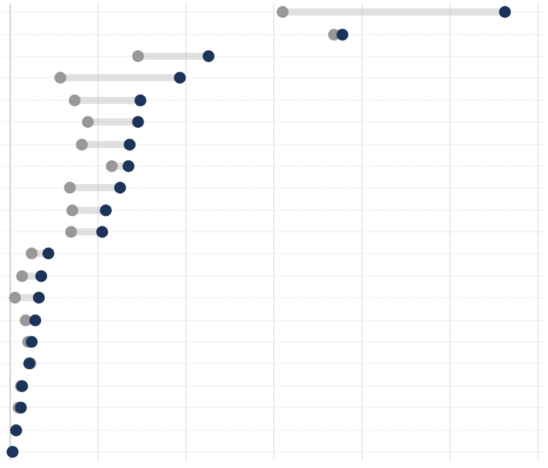
Credit Types Awarded
Blurb about accreditation trends
Figure 6. Number of Credits Awarded by Credit Type
ANCC
ACCME
ACCME Non-Phys
APTA
IPCE
ADA
ASWB
AAPA
ACHE
ACPE-PHARM
APA
AOTA
NBCC
CDR
ACPE-TECH
BOC
ARBO / COPE
ASHA
AHIMA
CCMC
COPSKT
28,197.50
18,954.20
11,347.25
9,650.25
7,408.95
7,309.50
6,821.25
6,765.75
6,279.70
5,483.00
5,266.75
2,190.50
1,789.50
1,695.00
1,474.50
1,236.25
1,099.50
686.00
625.00
397.00
173.50
0 | 5,000 | 10,000 | 15,000 | 20,000 | 25,000 | 30,000
2023
2024
Notes:
Went to meetings and conferences to promote our program — clinical communities monthly meeting in early 2024 (10 min virtual presentation)
3C conference in May, with a booth with flyers (Dr. O gave similar presentation)
Booth at the MHS conference with 3 representative, which led to networking and making connections; Gained a speaker for a future CCSS meeting
Moving to adobe
Adding resources
Looking forward to 2025
**Maybe link to the site

Slide 16
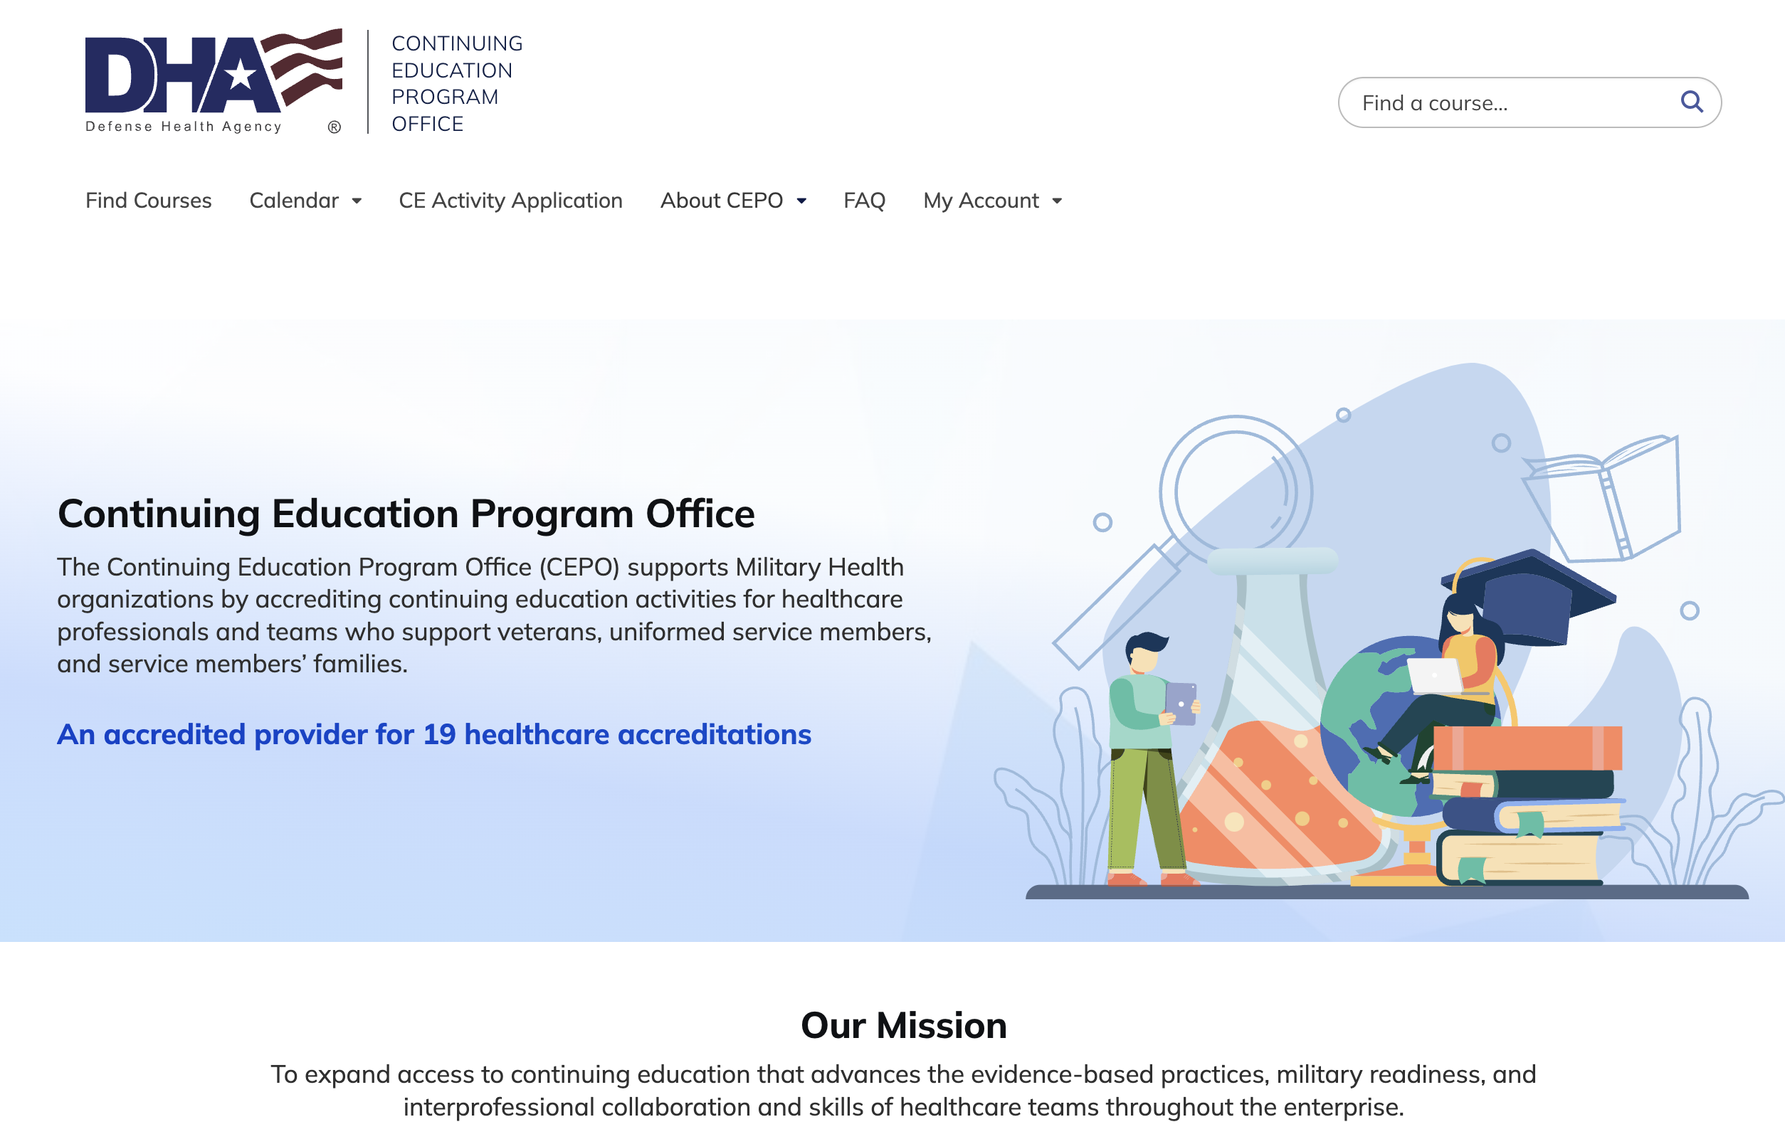





Marketing and Outreach
In CY24, CEPO strengthened its brand by honing its messaging, optimizing communication channels, and redesigning its website and key marketing materials to cultivate engagement in lifelong learning.
Branding
Refining CEPO’s mission and messaging
As an education-focused organization, CEPO modified its messaging and mission statement to highlight the program’s expected results in terms of changes in healthcare teams’ skills/strategy.
Outreach
Expanding communication channels
CEPO added thousands of healthcare practitioners to its email distribution list while making it easier for continuing education seekers to sign up for CEPO’s monthly CE newsletter directly from the website.
Design
Modernizing marketing collateral
CEPO revamped the design of its marketing materials, including the monthly newsletter and marketing emails, to increase readability and engagement.
User Interface/User Experience (UI/UX)
Streamlining access to continuing education
CEPO developed a sleeker user interface for its CE website to ease registration and simplify the process for claiming continuing education credits.
11,537
User profiles created on the CE website
8,594
Emails added to the CE distribution list
Notes:
Went to meetings and conferences to promote our program — clinical communities monthly meeting in early 2024 (10 min virtual presentation)
3C conference in May, with a booth with flyers (Dr. O gave similar presentation)
Booth at the MHS conference with 3 representative, which led to networking and making connections; Gained a speaker for a future CCSS meeting
Moving to adobe
Adding resources
Looking forward to 2025
**Maybe link to the site

Slide 17

Collaboration with our Partners
1
Collaborated with DHA stakeholders, Network Education & Training leads, and the Department of Veterans Affairs during the monthly IPCE meetings to provide accreditation updates, highlight upcoming events, and share special highlights from our stakeholders
3
Maintained effective two-way communication with Vision Center of Excellence (VCE), Traumatic Brain Center of Excellence (TBICoE) and Military Medical Library (MML) to obtain announcements for CEPO looping slides and share CCSS flyers to increase engagement
2
4
Collaborated with DHA Academy, CoE, and National Institutes of Health (NIH) stakeholders to support continuing education courses, such as CCSS events and content reviews
Collaborated with DHA teams for the DHA Network and MTF Directors Symposium, the Annual Ethics Training, the CMO/CNO/CDO Training, and the Joint Medical Executive Skills Program (JMESP) refresh
Partnership Spotlight
Department of Veterans Affairs
This year, the CEPO team continued its efforts to strengthen its partnership with the VA. Efforts included the successful closeout and completion of FY2024 Plan of POAMM for VA/DHA collaboration. A new POAMM for FY2025 was proposed by CEPO and VA, and it approved by the Healthcare Operations Business Line (HCOBL) in October. The new POAMM builds upon current collaborative activities to encourage VHA participation at CEPO events. Planned activities include coordinating with VHA partners to pick veteran-specific topics for future CCSS events, posting CEPO events on the VHA Institute for Learning, Education, and Development (ILEAD) website, and increasing the proportional number of VA attendees at CCSS events.
In continuation of its partnership with the VHA, CEPO supported six (6) focus groups throughout the year to obtain feedback on CCSS events. Our VHA partners led two focus groups in August. CEPO helped with outreach, developed a facilitator script, presented slides, and contributed to the focus group hot wash to discuss developments and participants’ feedback.
Continue to strengthen CEPO’s partnership with the VA by promoting educational content that’s relevant to VA practitioners and stakeholders
Partner with subject matter experts from federal organizations (e.g., CDC, NIH, FDA, SAMHSA), Centers of Excellence, and academia for CCSS events, IPCE meetings, advertising CEPO services, etc.
Looking ahead to 2025…
Notes:
Went to meetings and conferences to promote our program — clinical communities monthly meeting in early 2024 (10 min virtual presentation)
3C conference in May, with a booth with flyers (Dr. O gave similar presentation)
Booth at the MHS conference with 3 representative, which led to networking and making connections; Gained a speaker for a future CCSS meeting
Moving to adobe
Adding resources
Looking forward to 2025
**Maybe link to the site

Slide 18




Event Planning
In 2024, CEPO provided event planning support spanning attendee management, communication and outreach, logistical coordination, and on-site support. For the first time, CEPO utilized an event planning tool (CVENT) to assist with the logistical components of event planning. This proved to be extremely helpful for the Network and MTF Directors Symposium from 23-27 September. The event planning tool streamlined the symposium’s logistics to support increased demands for various reports and information.
Planning
The Network and MTF Director’s Symposium hosted 500+ leaders, requiring immense attendee coordination and complex venue planning by the CEPO team, including managing the website and the CVENT team. The CVENT event planning tool made it possible for CEPO to create and maintain the event website, conduct surveys, and manage registration.
Execution
The CEPO team utilized CVENT’s badge printing kiosks, which synchronized information from the CVENT registration website. Many attendees remarked on the ease of the registration and badging process. CEPO also provided technical and AV support throughout the event, including recording and editing each plenary session and scanning badges for those seeking credit.
Reflecting & Reporting
Surveys for the symposium were created using the CMS survey tool, with the links embedded into the CVENT application. Insights – both from survey results and CEPO team observations – were documented in an AAR with recommendations for future events.
Survey Result Highlights
“Conference support staff are great and organized!”
4.83/5 Stars
Average Rating for Mobile App
Looking ahead to 2025…
Event Planning Tool: CEPO recommends utilizing an event planning tool (such as CVENT) for event logistics, as it enabled the team to assist with several aspects of planning, execution, and reporting. Doing so led to a smooth participant experience, with many commenting about the ease of the registration process.
Advanced Planning: Including CEPO in the planning process as early as possible allows the team to take deliberate action throughout the process and avoid last-minute coordination
XX Framework: Follow XX Framework to provide J-7 event planning support with clear expectations

Slide 19
Event Planning
In 2024, CEPO provided event planning support spanning attendee management, communication and outreach, logistical coordination, and on-site support. For the first time, CEPO utilized an event planning tool (CVENT) to assist with the logistical components of event planning. This proved to be extremely helpful for the Network and MTF Directors Symposium from 23-27 September. The event planning tool streamlined the symposium’s logistics to support increased demands for various reports and information.
Planning
The Network and MTF Director’s Symposium hosted 500+ leaders, requiring immense attendee coordination and complex venue planning by the CEPO team, including managing the website and the CVENT team. The CVENT event planning tool made it possible for CEPO to create and maintain the event website, conduct surveys, and manage registration.
4.83/5 Stars
Average Rating for Mobile App
Execution
The CEPO team utilized CVENT’s badge printing kiosks, which synchronized information from the CVENT registration website. Many attendees remarked on the ease of the registration and badging process. CEPO also provided technical and AV support throughout the event, including recording and editing each plenary session and scanning badges for those seeking credit.
“Conference support staff are great and organized!”
Reflecting & Reporting
Surveys for the symposium were created using the CMS survey tool, with the links embedded into the CVENT application. Insights – both from survey results and CEPO team observations – were documented in an AAR with recommendations for future events.
Survey Result Highlights
Looking ahead to 2025…
Event Planning Tool: CEPO recommends utilizing an event planning tool (such as CVENT) for event logistics, as it enabled the team to assist with several aspects of planning, execution, and reporting. Doing so led to a smooth participant experience, with many commenting about the ease of the registration process.
Advanced Planning: Including CEPO in the planning process as early as possible allows the team to take deliberate action throughout the process and avoid last-minute coordination
XX Framework: Follow XX Framework to provide J-7 event planning support with clear expectations

Slide 20

Cost Savings and Return on Investment
CEPO strives to accredit and deliver educational content using cost-effective tools and industry best practices. To meet this objective, team members regularly identify and pursue opportunities to consolidate technological and operational capabilities and eliminate unnecessary expenses. CEPO’s decision to migrate operations from SSMC1 in Silver Spring, Maryland, to DHHQ in Falls Church, Virginia, in early 2023 has recouped $79,000 of redundant rental expenditures each year. Additionally, using Microsoft Teams in favor of Adobe Connect for webinars and transcription services has saved CEPO $199,000 annually. Lastly, CEPO’s status as a government organization waived $1,500 in ACHE provider fees.
Annual Cost
Return on investment
Measurement | CY2023 | CY2024
Commercial cost of 1.0 CE credit | $49 | $52
Number of CE credits awarded | 80.2K | 124.8K
Commercial value of CE credits awarded | $3.95M | $6.45
CEPO program costs | $3.14M | $3.19M
Return on investment | 26% ($808K) | 103% ($3.27M)
$3.27M
Value-add in 2024
$279.5K
Cost Savings
+
To estimate the return on investment from CEPO’s CE program, we compared the program’s annual expenditures to the commercial value of CE credit hours awarded in 2024. We estimated the average commercial cost of earning 1.0 CE credit by dividing the average amount spent on continuing education in 2024 by the average number of credit hours required for professional licensure. The average commercial cost of 1.0 CE credit was used to estimate the total commercial value of the sum of CE credits issued through CEPO in 2024.

Slide 21

Key Takeaways and Recommendations (1 of 2)
CEPO remains committed to our foundational principals of reducing cost associated with CE for health professionals, while maintaining educational requirements and competency to provide the best possible care to beneficiaries. The following are key recommendations for 2025 based on our assessment of CY24.
Strengthen our strategic relationships with key stakeholders to expand outreach efforts
In 2024, CEPO engaged with stakeholders through meetings, monthly email blasts, and conferences. Key recommendations include:
Conduct more frequent meetings with the VA to obtain insight into CEPO processes and ensure they are active participants in CCSS planning Continue to find ways promote CE/CME opportunities to new and existing stakeholders, such as utilizing our stakeholders’ channels for advertising Engage regularly with DHA stakeholders across different channels (e.g., attend Clinical Communities meeting and have a CEPO booth at DHA conferences) to advertise our program and CE/CME events Provide looping slides and CEPO tri-fold brochures at events, even if the team is unable to be physically present
Continue to focus on efficiency and process improvement
In 2024, CEPO focused on process improvements and user experience enhancements; some in support of the JA reaccreditation process. Key recommendations include:
Provide a How to Obtain CE (HTOCE) demonstration, when requested, at the end of courses that CEPO supports so that learners have a better understanding of the HTOCE process and fewer questions later Look for ways to streamline support for extraneous tasks (2024 example: Simplifying the J-7 DHHQ Recording Studio intake request form) Continue to find ways to maximize user experience and research how CEPO might utilize tools to enhance its trainings, such as MS Teams Live and polling capabilities

Slide 22
Key Takeaways and Recommendations (2 of 2)
Prepare for JA Reaccreditation with Commendation
CEPO familiarized and enhanced its expertise with the JA reaccreditation process in 2024. Key recommendations include:
Conduct mock interviews with the CEPO team to ensure every person is aware of the type of questions the JA interviewers may ask and what data/information we need to have readily available Enhance CEPO team expertise in JA reaccreditation standards by meeting directly with JA, attending webinars, and/or becoming JA surveyors Ensure processes and policies meet all accreditation requirements and only accept applications for courses that align with CEPO requirements
Continue to utilize data analytics capabilities in new ways to measure success and improve CEPO processes
In 2024, data was utilized to inform the CEPO team on how to improve its processes, better serve its stakeholders, and focus its offerings. Key recommendations include:
Continue to track CE/CME numbers per accreditation to identify which courses are in demand. Pay particular attention to courses that enabled CEPO to provide 60% more credit hours in 2024 than in 2023 Send reminders for CCSS post-activity surveys to continue boosting survey completions and obtain feedback necessary to enhance the CEPO program Engage IPCE participants by continually looking for ways to revamp data metrics to ensure they are relevant to the audience, and utilize polling capabilities to gather input that will increase participation and attendance

